Slide 1
Day 9 – Power BI

Slide 2
Content
Introduction
Parts of Power BI
Power BI Desktop
Power BI Service
Power BI Components
Data Analysis Expressions (DAX)
Practical Demonstration of Data Modeling and Transformation from different sources
Practical Demonstration of Power BI and Dataverse
Power BI with excel
Power BI with External website (http)
Q&A

Slide 3
Introduction
Power BI is a collection of software services, apps, and connectors that work together to turn your unrelated sources of data into coherent, visually immersive, and interactive insights
Your data may be an Excel spreadsheet, or a collection of cloud-based and on-premises hybrid data warehouses.
Power BI lets you easily connect to your data sources, visualize and discover what's important, and share that with anyone or everyone you want.
Power BI consists of several elements that all work together, starting with these three basics:
A Windows desktop application called Power BI Desktop.
An online SaaS (Software as a Service) service called the Power BI service.
Power BI mobile apps for Windows, iOS, and Android devices.

Slide 4
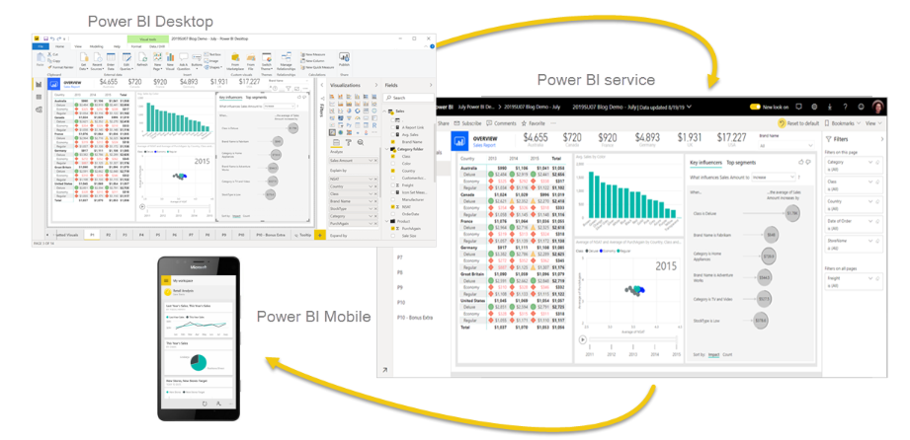
Parts of Power BI
Power BI consists of several elements that all work together, starting with these three basics:
A Windows desktop application called Power BI Desktop.
An online SaaS (Software as a Service) service called the Power BI service.
Power BI mobile apps for Windows, iOS, and Android devices.

Slide 5
Power BI Desktop
Power BI Desktop is a free application you install on your local computer that lets you connect to, transform, and visualize your data.
You can connect to multiple different sources of data and combine them (often called modeling) into a data model.
This data model lets you build visuals, and collections of visuals you can share as reports, with other people inside your organization.
Most users who work on business intelligence projects use Power BI Desktop to create reports, and then use the Power BI service to share their reports with others
The most common uses for Power BI Desktop are as follows:
Connect to data
Transform and clean that data(Data Modeling)
Create Visualizations
Create reports that are collections of visuals, on one or more report pages
Share reports with others by using the Power BI service

Slide 6
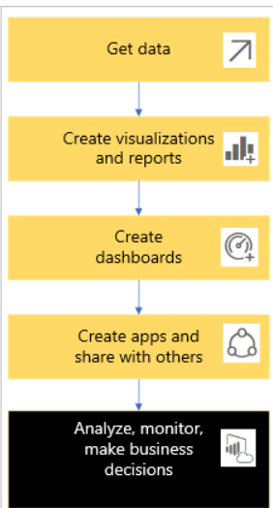
Power BI Service/Power BI Online
Power BI is a collection of software services, apps, and connectors that work together to help you create, share, and consume business insights
In Power BI service you can deal with below components
Dashboards
Reports
Datasets
Workspace

Slide 7
Power BI Components
Visualization (or visual), is a type of chart built by Power BI designers. The visuals display the data from reports and datasets. Because they are highly interactive, you can slice, filter, highlight, change, and even drill into visualizations.
Dataset is a container of data. It can be formed using different sources like Excel, Database file, web link etc
Dashboard is a single screen with tiles of interactive visuals, text, and graphics. A dashboard collects your most important metrics, on one screen, to tell a story or answer a question. The dashboard content comes from one or more reports and one or more datasets.
Report is one or more pages of interactive visuals, text, and graphics that together make up a single report. Power BI bases a report on a single dataset. Often, the designer organizes report pages to address a central area of interest or answer a single question
An app is a way for designers to bundle and share related dashboards, reports, and datasets together. Business users receive some apps automatically but can go search for other apps created by colleagues or by the community. For example, out-of-the-box apps are available for external services you may already use, like Google Analytics and Microsoft Dynamics CRM.

Slide 8
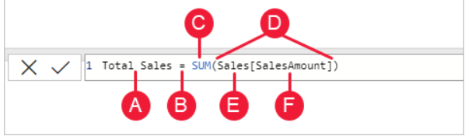
Data Analysis Expressions (DAX)
Data Analysis Expressions (DAX) is a programming language that is used throughout Microsoft Power BI for creating calculated columns, measures, and custom tables.
It is a collection of functions, operators, and constants that can be used in a formula, or expression, to calculate and return one or more values.
You can use DAX to solve a number of calculations and data analysis problems, which can help you create new information from data that is already in your model.
DAX helps you create new information from data already in your model.
You can write Quick measure and measures to write a calculated expressions using predefined formulae

Slide 9
Thank You

